Slide 1
Shitty games - beginnings
04.04.2021

Slide 2
Summary
Creating a game cycle
Set the expectations
The Idea
Brainstorming session
What is the MVP and what is nice to have?
HLE for the cycle steps
Action: Create a backlog of epics and break them down

Slide 3
Creating a game cycle
1_Planning Phase
Creative Briefs
Architecture
Design System
2_Pre-Production
Feature Briefs
Functionality
Wire frames
3_Production
HL mocks
Most of the coding should be done
Placeholder art (if necessary)
4_Post-Production
Testing
Art cut up
5_Tunning
Bug fixing
Polish Art
6_Release
Publishing

Slide 4
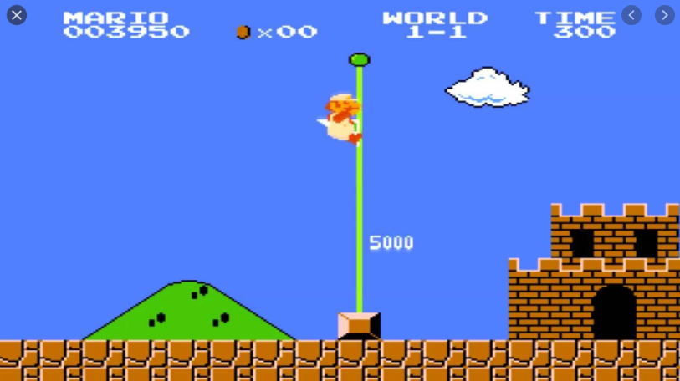
Set the expectations
L
O
W For example:
the first level of Super Mario >>

Slide 5

The idea
Our purpose
Create our first game together and find our current limitations
A Multiplayer Fighter Game
Possibilities are endless: Brawler (team fight), Battle royale, Mortal Kombat style
Create characters based on our selves with stupid abilities
2D
Unity
Spin off
Story mode where you have to beat all the bosses
We are the bosses
Tower defence

Slide 6
Brainstorming
25 minute

Slide 7
Features
MVP
One characters - Multiple faces
Randomizable map/scene/arena (2.5D)
Poll of abilities (10s countdown) - Ability screen
Score (K/D/A)
Health
Round of 5minutes and respawn
Client Server - multiplayer
Lobby Screen
Use Github for task management & documentation - Public Project
Nice to have
Multiple characters > Select screen
Character Skins
Events
Sound & music
Menu
Make Alliances
Leaderboard (needs further investigations)

Slide 8
HLE cycle steps
1_Planning Phase
TBD
Creative Briefs
Architecture
Design System
2_Pre-Production
TBD
Feature Briefs
Functionality
Wire frames
3_Production
TBD
HL mocks
Most of the coding should be done
Placeholder art (if necessary)
4_Post-Production
TBD
Testing
Art cut up
5_Tunning
TBD
Bug fixing
Polish Art
6_Release
TBD
Publishing

